Slide 1
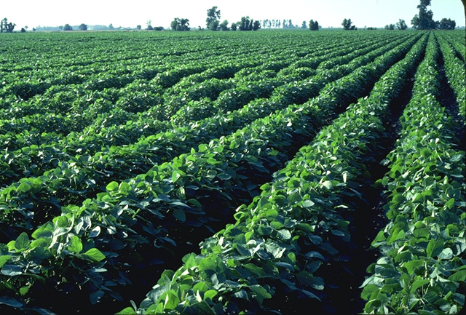
Roundup Ready Crops
Too Risky

Slide 2
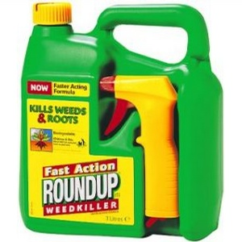
What are Roundup Ready Crops?
Crops that have been genetically engineered to be resistant to Roundup herbicide
Often these crops are made to create their own pesticide as well
Corn, cotton, canola, soybean,
flax, papaya, potatoes, squash,
sugar beets, red-hearted chicory,
alfalfa, and tomatoes

Slide 3
How are they made?
Recombinant DNA Technology
Polymerase Chain Reaction is used to replicate DNA on a large scale - http://www.youtube.com/watch?v=2KoLnIwoZKU
Restriction endonuclease - an enzyme that cuts strands of DNA at a specific point
Gene is inserted into a virus
Part of the virus that causes harm is cut out
Genes enter targets genome through harmless virus
http://www.youtube.com/watch?v=LSBnoGZoAHs&feature=related

Slide 4
Who created them?
Monsanto made GE crops commercially available in 1996
Agent Orange
Pollution in Anniston, Alabama
Dumping of toxic waste in the UK
Patents on seeds
Patent lawsuits against farmers
Banning of GE crops
Bribing of Indonesian officials
USDA lets Monsanto approve its own crops
False Advertising
Lobbying
Monsanto in bed with FDA and EPA?

Slide 5
Claimed Benefits
Increased yields and crop productivity
Improved protection from disease and insects, drought and heat
Reduced costs for farmers
Better food quality and taste
Making crops grow faster
Efficiency
Conservation of soil fertility, energy, and natural resources
Reduced greenhouse gases and use of toxic herbicides

Slide 6
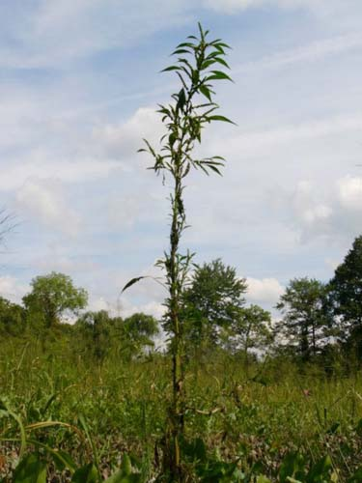
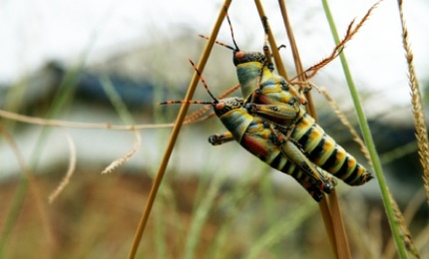
Negative effects of transgenic crops
Super-weeds
Super-pests
Loss of biodiversity
Bacterial infections
Lower yields
Unknown risks

Slide 7
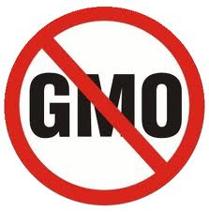
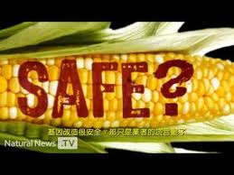
My stance
Not enough is known since independent and objective studies are restricted due to patent laws
We have seen some negative effects
We have seen that Monsanto can’t be trusted
We must see if the benefits outweigh the risks
Until more independent, objective and reliable research comes out, we should stop using Roundup Ready crops.
http://www.youtube.com/watch?v=1H9WZGKQeYg

